Slide 1

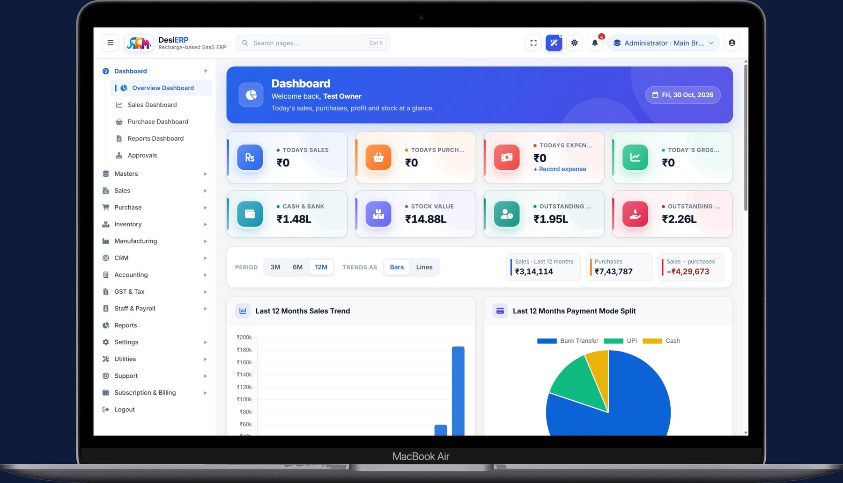
DesiERP
by SCM Software Lab
INDIA'S LOWEST-COST AI-POWERED SAAS ERP
The AI-powered cloud ERP for India.
Every module. ₹10 a day.
GST billing and e-Invoice, inventory, purchase, manufacturing, accounts, payroll, CRM, multi-branch controls and a built-in AI assistant, in your browser, paid by the day like a mobile recharge.
DesiERP by SCM Software Lab, Guntur, Andhra Pradesh · desi-erp.in

Slide 2
DesiERP
by SCM Software Lab
Indian businesses have had two bad choices
Small tools stop at billing. Big systems cost a licence, a consultant and a year.
Billing and accounting apps
Large ERP suites
Fine for the first invoice. Then the gaps show:
no purchase approvals, no production, no payroll rules, no branch controls, no audit trail.
Every extra need becomes another app, another login and another export.
The depth is there, and so is the price:
licence fees per user per year, an implementation project, AMC, and upgrade charges.
Out of reach for a shop, a distributor or a small factory.
DesiERP: the depth of a full ERP, every module included, at ₹10 a day per login. No licence, no AMC, no contract.
desi-erp.in · +91 90524 99309 · sales@scmsoftwarelab.com
2

Slide 3
DesiERP
by SCM Software Lab
One ERP, nine modules, every login
Nothing to buy later. Whichever recharge you pick, every login gets all of this.
Sales & GST billing
GST & e-Invoice
Purchase
Invoices, quotes, POS, e-Invoice, e-way bill, receipts
GSTR-1, 3B, 2B reconciliation, HSN and rates
Requisitions, RFQs, approvals, POs, GRN, bills with TDS
Inventory
Manufacturing
Accounts
Warehouses, racks, batches, serials, expiry, reorder
Multi-level BOMs, plans, job cards, costing
Double entry, bank reconciliation, P&L, balance sheet
Payroll & HR
CRM
Controls & AI
PF, ESI, PT, LWF, TDS, bonus, payslips, F&F
Leads, follow-ups, deals, campaigns, tickets, loyalty
Branches, roles, approvals, audit trail, AI assistant
desi-erp.in · +91 90524 99309 · sales@scmsoftwarelab.com
3

Slide 4
DesiERP
by SCM Software Lab
Pay like a mobile recharge
Recharge each login for the days you need. The longer the recharge, the less you pay per day.
₹10
₹8.50
₹100
₹1
a day, per login
a day on a yearly recharge
one-time setup
per e-Invoice or e-way bill
plus GST; every module included
₹3,103 per login for the whole year
paid with the first recharge only
the GST Suvidha Provider's charge, bought as credits
Nothing else, ever
No licence fee
No AMC
No contract
No upgrade fees
No charge for new features
No extra for any module
Free read-only login for your CA
desi-erp.in · +91 90524 99309 · sales@scmsoftwarelab.com
4

Slide 5
DesiERP
by SCM Software Lab
Every Indian rule, already in the software
Compliance is done from the documents you already make, not re-entered in a portal.
GST billing & returns
e-Invoice & e-way bill
Payroll statute
GSTR-1 and GSTR-3B prepared from your invoices; GSTR-2B reconciliation; HSN and rate masters; composition and SEZ parties handled.
IRN and e-way bills generated from the invoice through a GST Suvidha Provider, with the checks run before anything is sent.
PF, VPF, ESI, professional tax, LWF, TDS and bonus worked out by the rules; payslips and full-and-final settlements.
Branches & GSTINs
TDS & TCS
Indian masters
Branches with their own GSTIN, place of supply decided per document, CGST/SGST or IGST split automatically.
TDS on supplier bills and salaries, TCS on customer invoices, sections and rates kept on the masters.
PIN-code addresses with state and city, IFSC lookup, UPI QR on invoices, rupee formatting everywhere.
desi-erp.in · +91 90524 99309 · sales@scmsoftwarelab.com
5

Slide 6
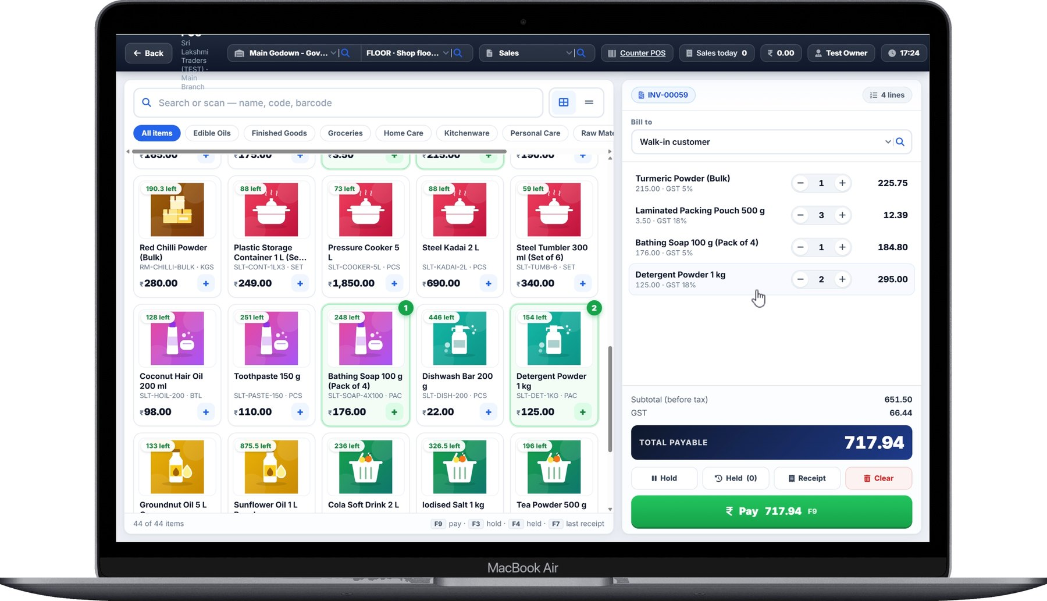
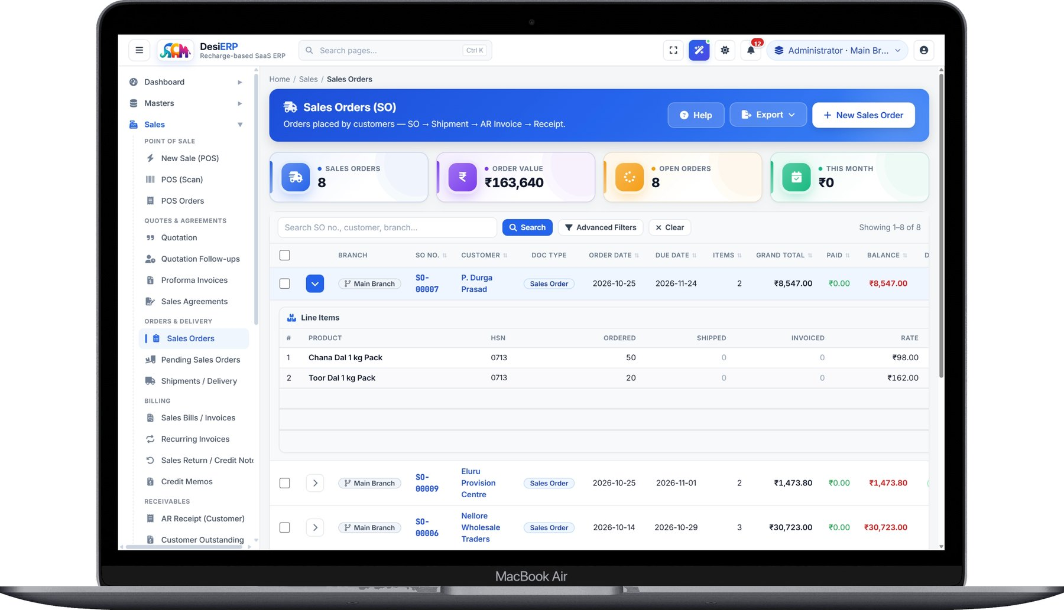
DesiERP
by SCM Software Lab
Sell at the counter and on account
Scan-and-pay POS for the shop floor, sales orders for the trade, e-Invoice from both.
POS (Scan): touch a product, scan a barcode, take UPI, card or cash.
Sales Orders: order to shipment to invoice to receipt, in one chain.
POS billing
Sales orders and invoices
Barcode and touch billing, hold and recall bills, receipts
UPI QR, card and cash, split payments
Quotations, orders, invoices, credit notes, receipts
e-Invoice (IRN) and e-way bill from the invoice
desi-erp.in · +91 90524 99309 · sales@scmsoftwarelab.com
6

Slide 7
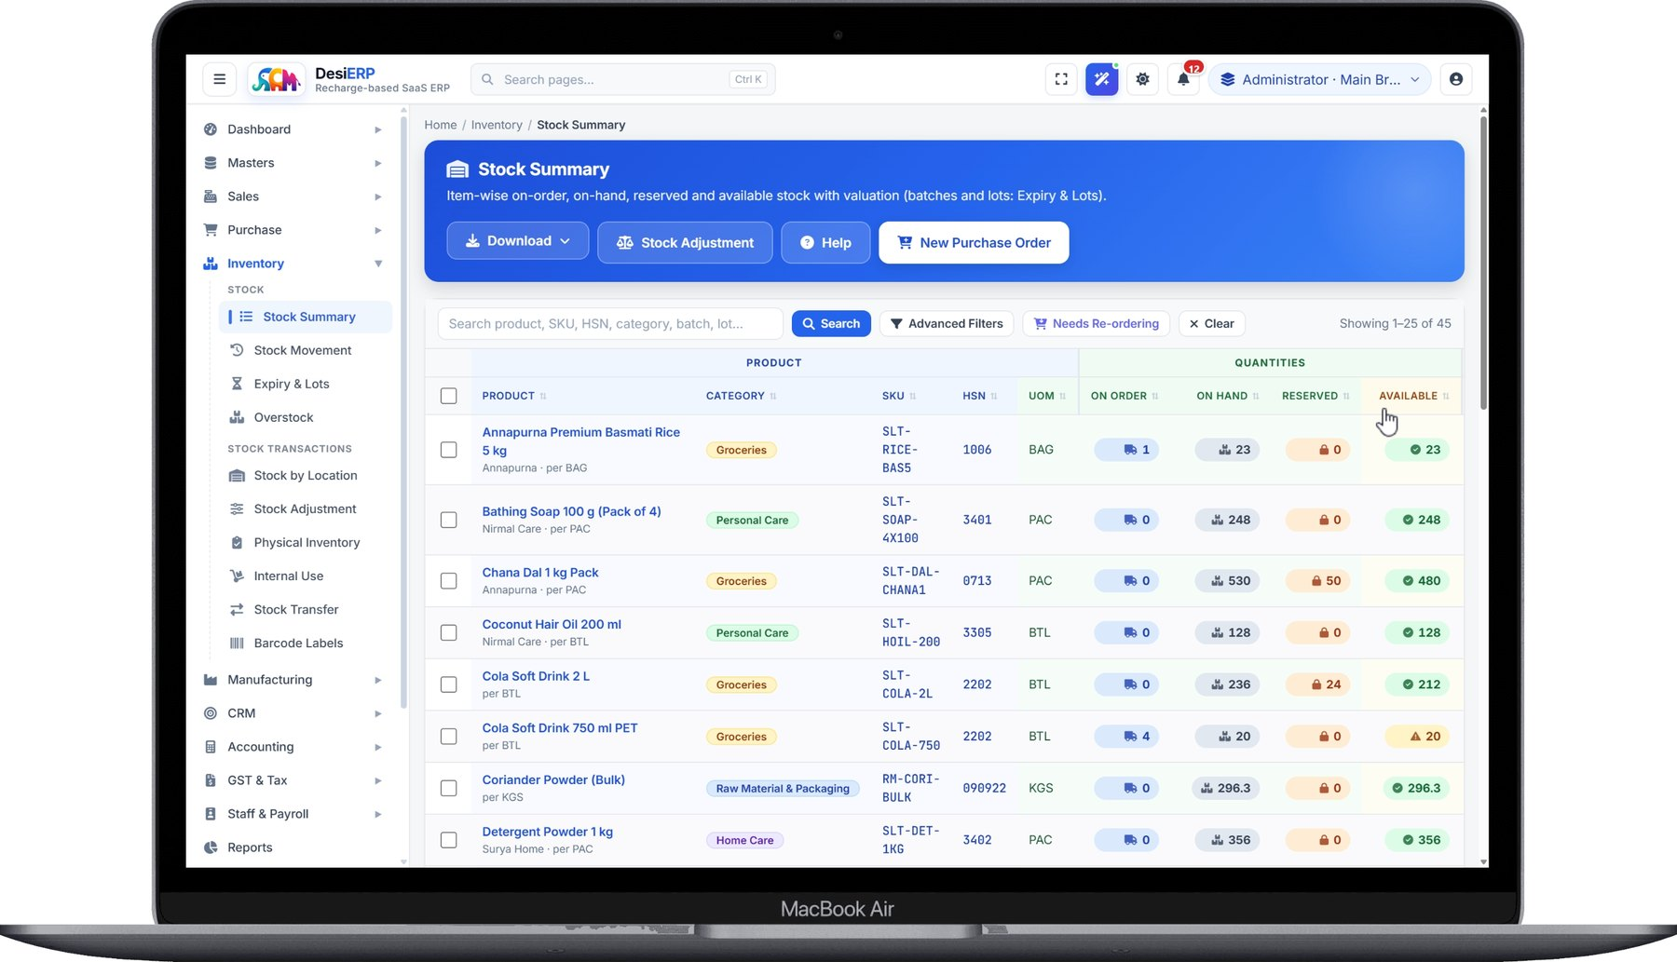
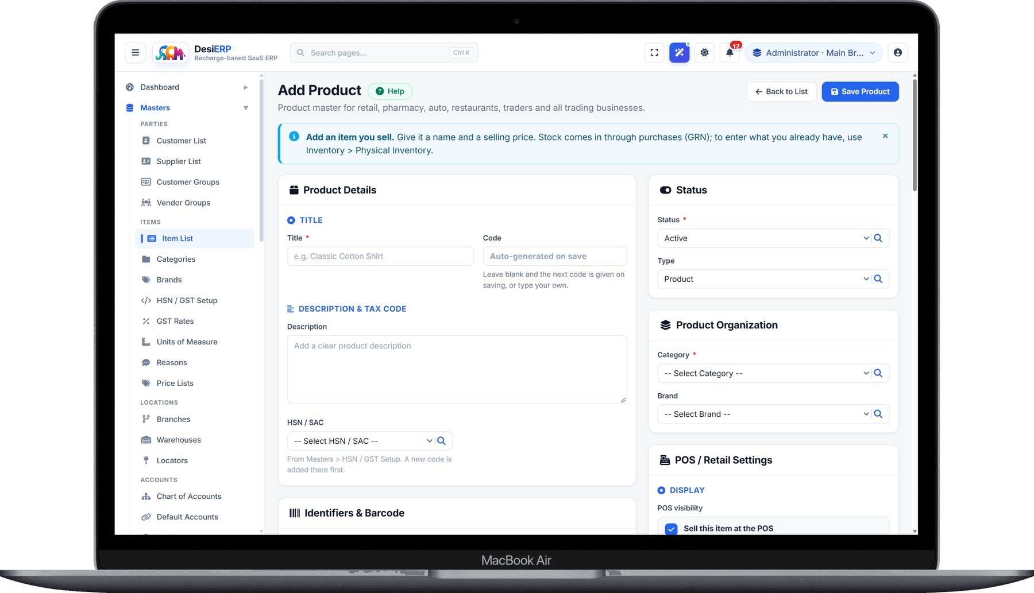
DesiERP
by SCM Software Lab
Know exactly what you have, and where it is
Every item, every batch, every rack, with on-order and reserved stock in view.
Stock Summary: on order, on hand, reserved and available, item by item.
Add Product: HSN, GST rate, barcode, units and POS settings on one form.
Inventory
Item master
Warehouses, racks, batches, serials and expiry
Reorder levels, transfers, adjustments, stock ledger
HSN and GST rate from the masters, barcode and QR labels
Categories, brands, units of measure, price lists
desi-erp.in · +91 90524 99309 · sales@scmsoftwarelab.com
7

Slide 8
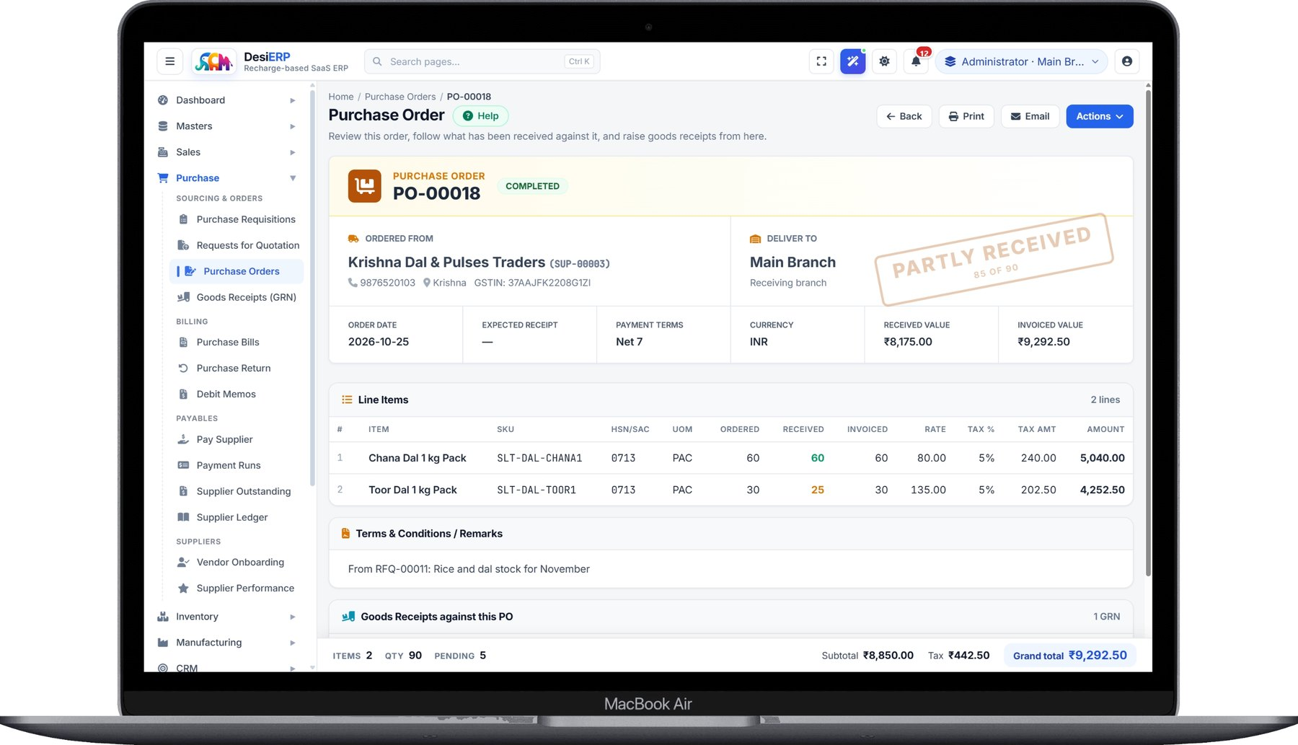
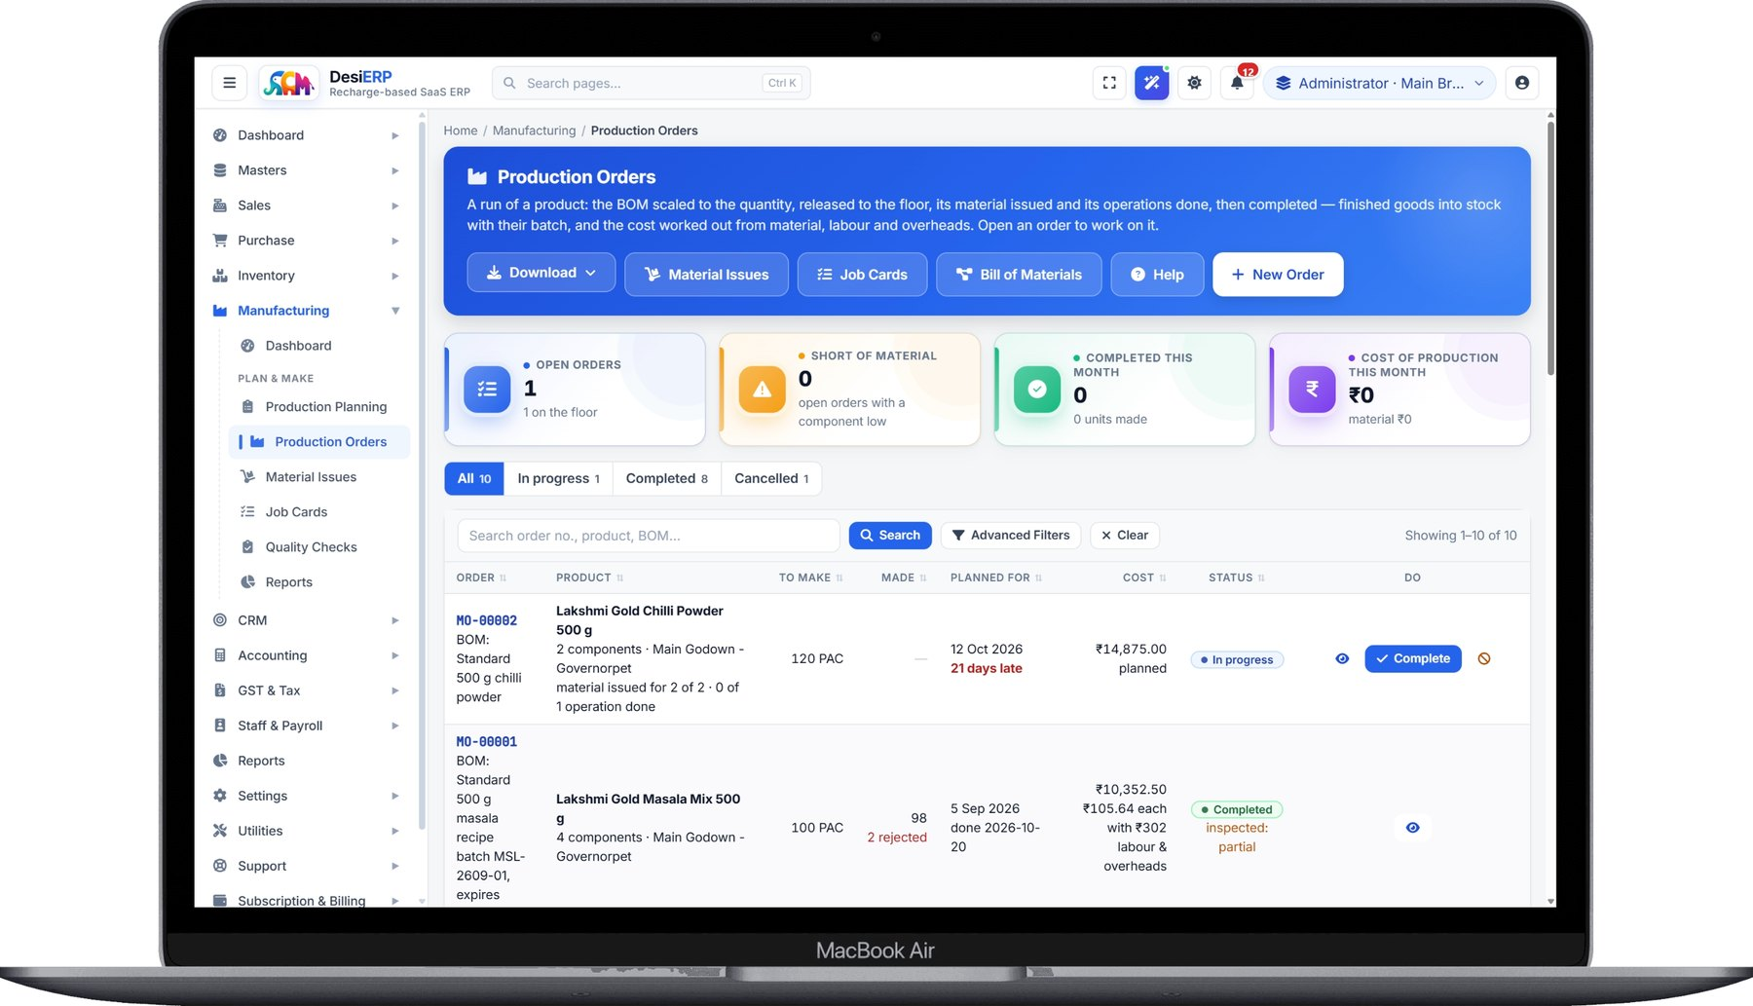
DesiERP
by SCM Software Lab
Buy with control, make with a plan
The engines that make DesiERP an ERP rather than a billing tool.
Purchase Order: what was ordered, received and invoiced, with the GST split.
Production Orders: BOM scaled to quantity, material issued, output, cost.
Purchase
Manufacturing
Requisitions, RFQs, approval limits, orders, goods receipt
Bills with TDS, returns to vendor, supplier payments
Multi-level BOMs, production plans with shortages
Job cards, material issue, wastage, quality, costing
desi-erp.in · +91 90524 99309 · sales@scmsoftwarelab.com
8

Slide 9
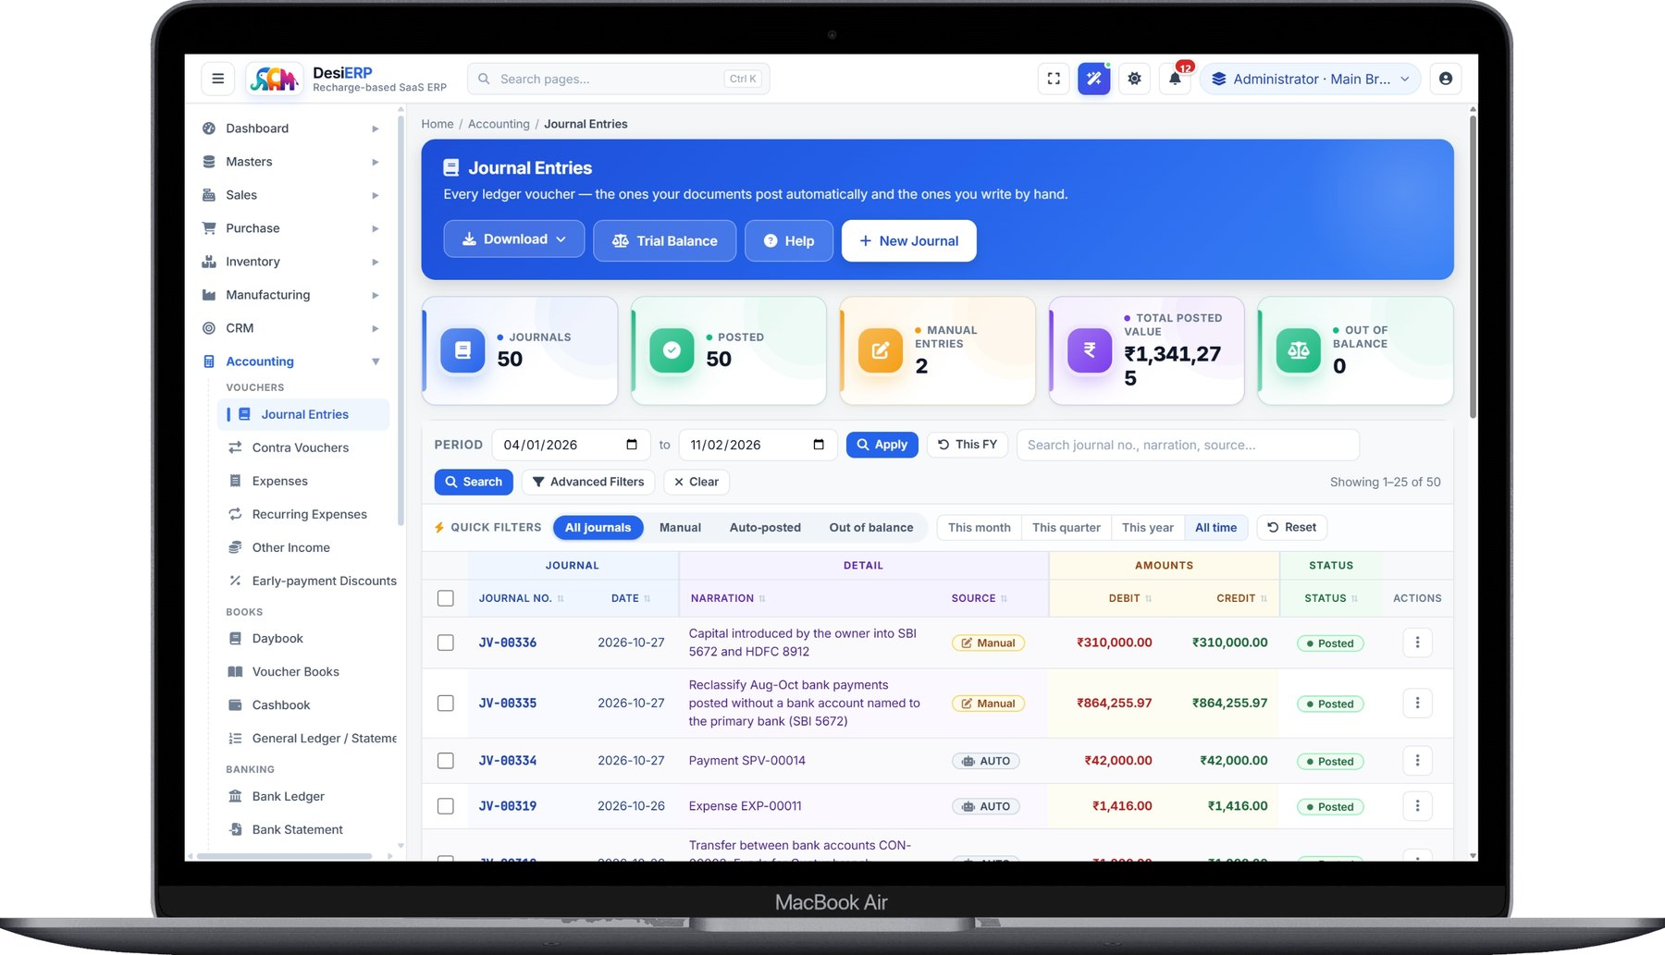
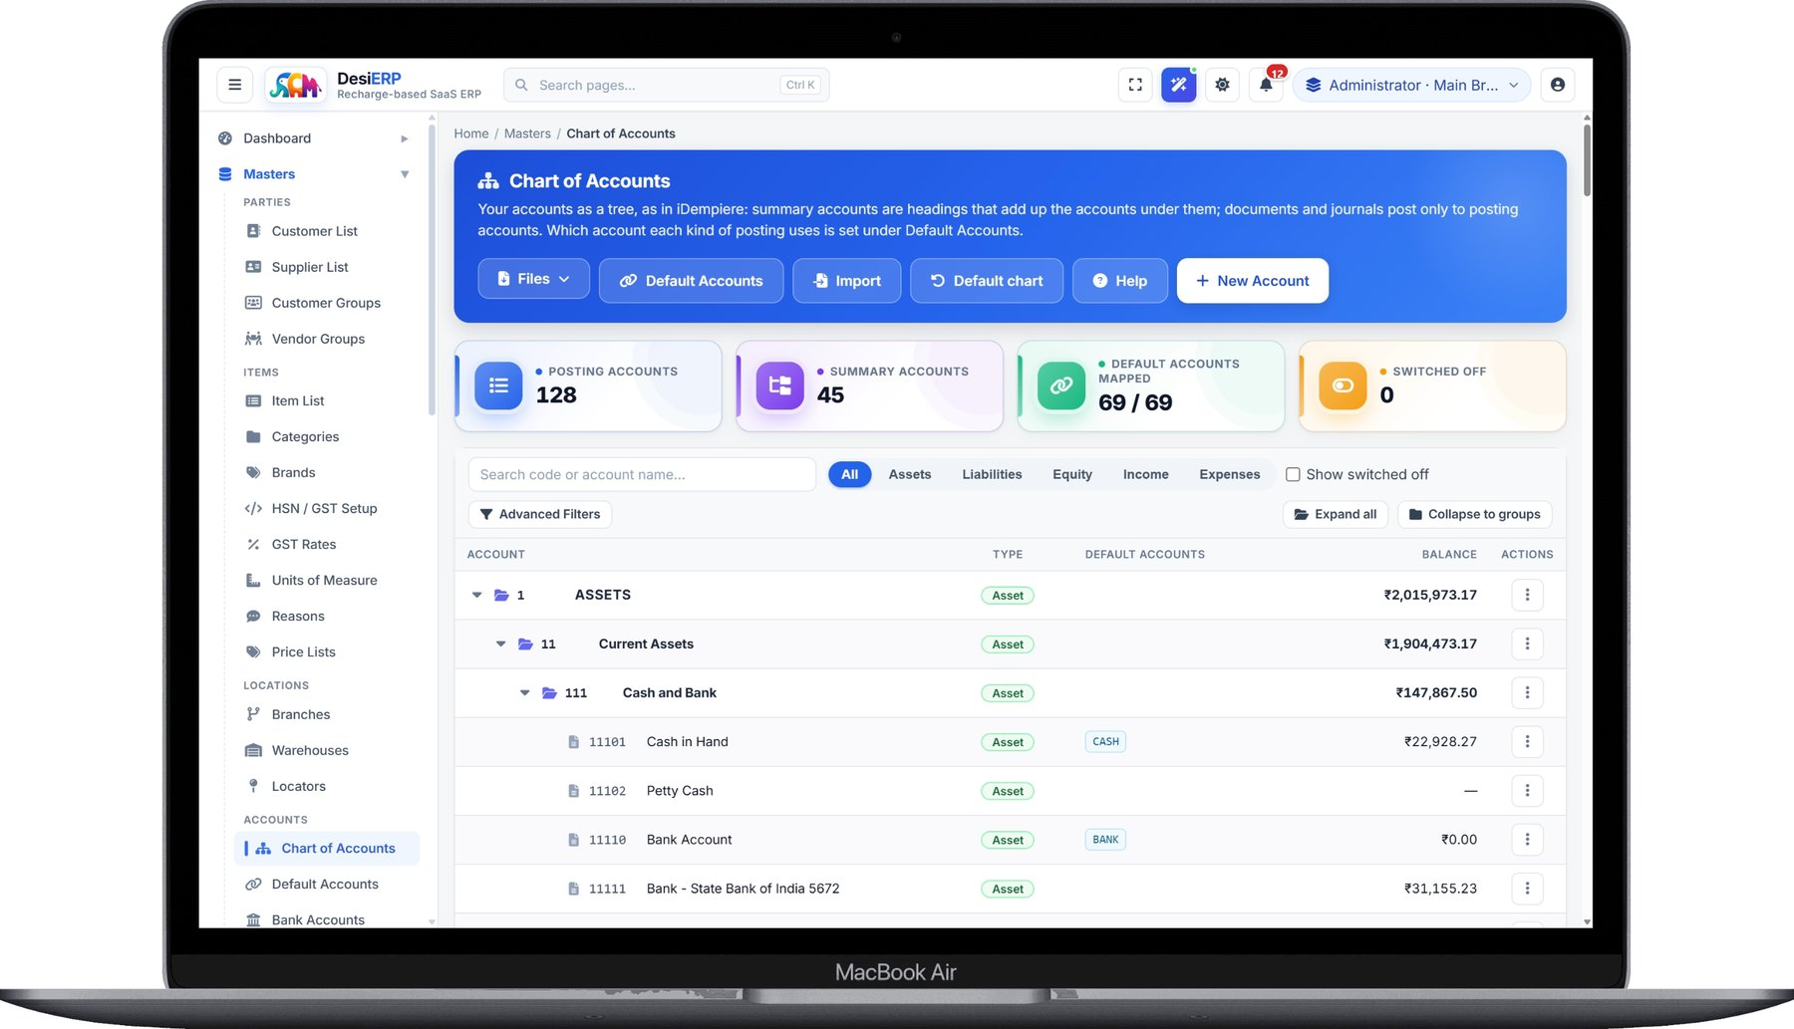
DesiERP
by SCM Software Lab
Books that keep themselves up to date
Every document posts its own journal; the chart of accounts is a tree, as in the big systems.
Journal Entries: the ones your documents post automatically and the ones you write.
Chart of Accounts: summary accounts as headings, postings only to default accounts.
Accounts
For your accountant
Bank reconciliation, day book, ledgers, trial balance, P&L, balance sheet
Perpetual inventory: stock posts to the books at cost
Tally export, Excel export of any list or report
A free read-only login for your chartered accountant
desi-erp.in · +91 90524 99309 · sales@scmsoftwarelab.com
9

Slide 10
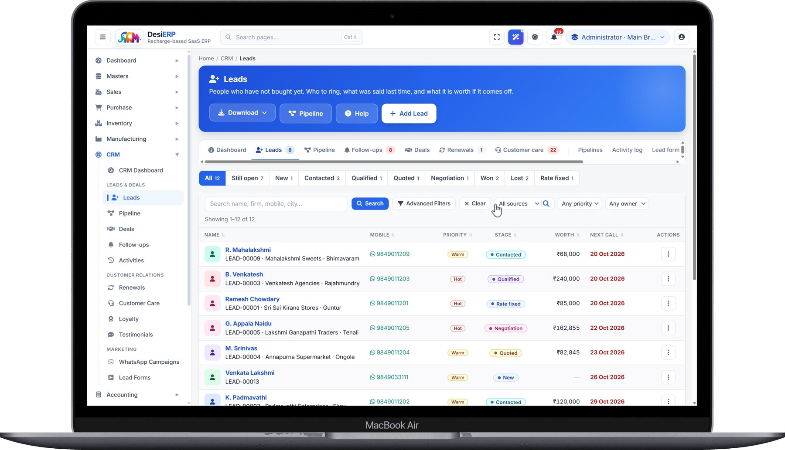
DesiERP
by SCM Software Lab
Win customers, pay your people
CRM tied to the same customers and invoices; payroll that follows Indian law and explains itself.
Payroll & HR
Employees, shifts, attendance and leave
Salary structures with PF, VPF, ESI, PT, LWF, TDS and bonus, worked out by the rules
Payslips that show how each figure was arrived at
Bank advice, full-and-final settlements, statutory reports ready for filing
Employee self-service through the same login
Leads: who has not bought yet, who to ring, what was said last time, what it is worth.
CRM
Leads, follow-ups, pipeline, campaigns, customer care, loyalty and renewals
desi-erp.in · +91 90524 99309 · sales@scmsoftwarelab.com
10

Slide 11
DesiERP
by SCM Software Lab
Ask your business anything, in plain English
A built-in AI assistant that answers from your own data, included with every login.
DesiERP AI Assistant Private · on our servers
Answers from your own data
A total, a ranked list or a trend, with a one-line "I read it as" and a link to the full report.
which customers owe us the most?
Private by design
OUTSTANDING RECEIVABLE BY CUSTOMER · AS OF TODAY
The model runs on DesiERP's own servers. Nothing goes to an outside AI company, and it never sees your figures, only your question and master names.
₹4,86,250 across 8 customers
Sri Venkateswara Agencies
₹1,82,400
Follows your roles
Lakshmi Provision Store
₹1,12,900
A user who cannot open Purchase Bills cannot ask about payables. Unsure questions are asked back, not guessed.
Guntur Kirana Mart
₹74,300
items below reorder level
Included
Ask anything about your business…
Part of every login at the normal recharge price. No per-question fee.
desi-erp.in · +91 90524 99309 · sales@scmsoftwarelab.com
11

Slide 12
DesiERP
by SCM Software Lab
Controls that grow with the company
What a second branch, a tenth user or an auditor will ask for.
Roles & permissions
Approval limits
Audit trail
Page by page: who may read, write and delete. Sales staff never see salaries.
Purchases and expenses above an amount wait for the right person.
Every change recorded with who made it and when. Nothing changes silently.
Branches & warehouses
Multi-currency & API
Your own server
Branch GSTINs, branch-wise access, stock and figures across all of them.
Documents in any currency with the rate kept on them; a REST API with keys per business.
Larger companies can have DesiERP installed on their own server or cloud account, supported by us.
desi-erp.in · +91 90524 99309 · sales@scmsoftwarelab.com
12

Slide 13
DesiERP
by SCM Software Lab
Made for the business you run
The same ERP, set up for how each trade actually works.
Retail & supermarkets
Wholesale & distribution
Manufacturing
POS, barcodes, UPI QR, loyalty
Routes, credit limits, outstanding
BOMs, plans, job cards, costing
Pharma & medical
Textiles & garments
Electronics & mobile
Batches, expiry, drug licence
Sizes, colours, job work
Serial numbers, warranty
Services
Jewellery
Chartered accountants
Quotes, agreements, renewals
Weights, purity, making charges
A free read-only login per client, Tally export
desi-erp.in · +91 90524 99309 · sales@scmsoftwarelab.com
13

Slide 14
DesiERP
by SCM Software Lab
Start for the price of a cup of chai a day
Sign up, import your items and customers from Excel, and bill the same day. Every module, from the first day.
1
Sign up
2
Recharge
3
Set up
4
Start billing
at app.desi-erp.in with your mobile number
any number of days, from ₹10 a day
we help with masters and data import
GST invoices and e-Invoices today
Website
Call or WhatsApp
E-mail
desi-erp.in
+91 90524 99309
sales@scmsoftwarelab.com
SCM Software Lab · D No: 31-15-1311, 2nd Floor, 15/2 Arundelpet, Guntur, Andhra Pradesh 522002, India
DesiERP is made only by SCM Software Lab, Guntur, and is not connected with any other app or company using the name Desi ERP.

